Slide 1

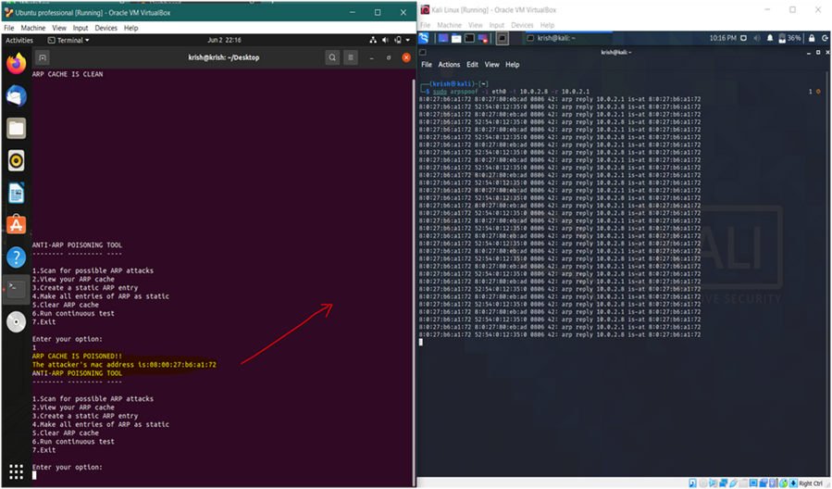
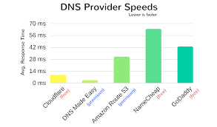
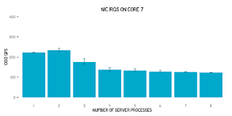
Anti-DNS Spoofing
Project Group ID:- 8
Vakul Raina, Aryan Khatri, Sarthak Yadav, Raghunandan Tomar
Guided by- Dr. Hariharasitaraman.S
ABSTRACT
INTRODUCTION
RESULTS
DISCUSSION
In a LAN, the systems communicate with each other using MAC addresses instead of IP addresses. To make this communication faster, every system in that LAN stores a cache of various IP addresses in the network along with its corresponding MAC address. This cache of IP and MAC is called an ARP cache. Thus the Address Resolution Protocol (ARP) is used to provide mapping between the Network Layer and the Data Link Layer. The attacker can also choose to send fake DNS replies to the victim which makes the victim redirected to any website as wished by the attacker. hese attacks, and theoretically, This is capable of detecting and preventing potential ARP attacks just by analysing the ARP cache of the system. The fact that static ARP entries cannot be changed automatically is used to prevent ARP poisoning by attackers.
In this project, detailed instruction to perform various man-in-the middle attacks are discussed. The attacks are simulated in a controlled environment using virtual machines hosted on a single system. The attacks discussed are ARP cache poisoning to get username and password of users, DOS (Denial of Service) and DNS(Domain Name System) cache poisoning.
All these attacks require both the victim and the attacker to be in the same Local Area Network. This is because in a LAN, the systems communicate with each other using MAC addresses instead of IP addresses. To make this communication faster, every system in that LAN stores a cache of various IP addresses in the network along with its corresponding MAC address. This cache of IP and MAC is called an ARP cache. Thus the Address Resolution Protocol (ARP) is used to provide mapping between the Network Layer and the Data Link Layer.
In this project, we have successfully implemented ARP poisoning, DOS, and DNS poisoning attacks. We have also recorded the procedure and explained it step-by-step in great detail. Even though these attacks have a limitation of only working on LAN, these are very common and easily performed and virtually undetectable by a novice. As a result, this is a threat that has to be addressed. So, we have come up with an app “anti-Dns” which is capable of detecting, preventing and recovering from an ARP poisoning attack on the victim’s Linux system. This is written in python and mainly focuses on analyzing the ARP cache of the system to detect attacks. Also there are functions which have the capability of performing continuous scans after a certain regular interval of time.
ARP spoof (User Id and Password attack):- In this attack, we scanned for hosts on the local network and then added the victim as one of the targets and the gateway as the other target on ettercap and started ARP poisoning attack.
DNS Spoofing:- In this attack, Ettercap plays a very important role in enabling the ARP spoofing and DNS spoofing. We first scan the network for hosts and subsequently add the victim and the gateway as the targets. In the ettercap config, we enable the commands for Linux as we are working in a Linux based environment. We also used the in-built plugin available in ettercap for DNS spoofing.
MODULES AND METHODS
Figure: DNS Spoofing
CONCLUSIONS
Detection:- The detection mechanism is called anti-ARP, a simple python program that browses different IP addresses in the ARP cache and checks if any two IP addresses have the same MAC addresses or not. If they have the same MAC address, which means the ARP cache is poisoned
Prevention - For prevention, we designed an algorithm and coded it in python. This algorithm does the task of making all the entries in the ARP cache as static because of the fact that they cannot be altered by the attacker once made static
Recovery:- Once we have detected that ARP cache is poisoned, we can execute the recovery algorithm which is also coded in python. The main idea of the recovery process is copying a clean set of entries into the cache or altering a specific entry in the cache.
In this project, we have successfully implemented ARP poisoning, DOS, and DNS poisoning attacks. We have also recorded the procedure and explained it step-by-step in great detail. Even though these attacks have a limitation of only working on LAN, these are very common and easily performed and virtually undetectable by a novice. As a result, this is a threat that has to be addressed. So, we have come up with an app “anti-arp” which is capable of detecting, preventing and recovering from an ARP poisoning attack on the victim’s Linux system.
REFERENCES
[1] Y. Kim, S. Ahn, N. C. Thang, D. Choi and M. Park, "ARP Poisoning Attack Detection Based on ARP Update State in Software-Defined Networks," 2019 International Conference on Information Networking (ICOIN), Kuala Lumpur, Malaysia, 2019, pp. 366-371, doi: 10.1109/ICOIN.2019.8718158.
[2] B. Zdrnja, "Malicious JavaScript Insertion through ARP Poisoning Attacks," in IEEE Security & Privacy, vol. 7, no. 3, pp. 72-74, May-June 2009, doi: 10.1109/MSP.2009.72.
[3] S. Kumar and S. Tapaswi, "A centralized detection and prevention technique against ARP poisoning," Proceedings Title: 2012 International Conference on Cyber Security, Cyber Warfare and Digital Forensic (CyberSec), Kuala Lumpur, 2012, pp. 259-264, doi: 10.1109/CyberSec.2012.6246087.
.

